Slide 1
TJAGLCS Training Package
Intelligence Law & Policy
March 2025

Slide 2
The information provided throughout this training aid does not, and is not intended to, constitute legal advice; instead, all information, laws, statues, content, and materials for this training aid are for general informational purposes only. This training aid may not constitute the most up-to-date legal or other relevant legal information. Judge Advocates need to conduct their own due diligence through independent further legal research on any specific legal issue contained in this training package. No reader, user, or trainee of this product should act or refrain from acting based on information from this training aid without first seeking legal advice from an attorney in the relevant jurisdiction.

Slide 3
Intelligence Law & Policy

Slide 4
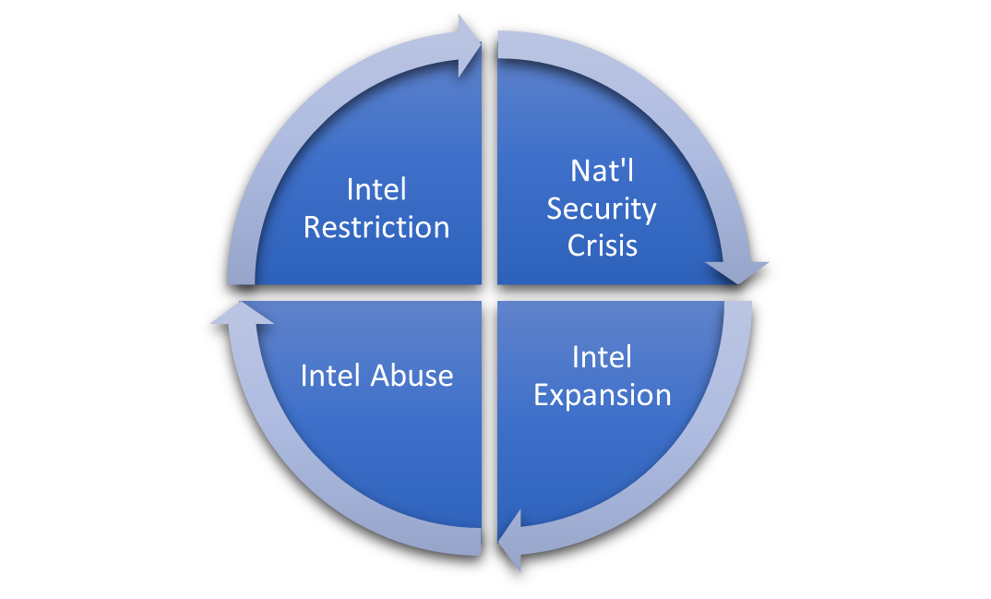
Intelligence Authorities Lifecycle: Crisis, Expansion, Abuse, Restriction

Slide 5
USP’s interest in constitutionally protected liberties
USG’s constitutional duty to protect and defend its citizens
Reasonable Expectation of Privacy
Provide for the Common Defense

Slide 6
Two Categories
Foreign Intelligence
Information relating to the capabilities, intentions or activities of foreign governments or elements, foreign organizations, foreign persons, or international terrorists.
Counterintelligence
Information gathered and activities conducted to identify, deceive, exploit, disrupt, or protect against espionage, other intelligence activities, sabotage, or assassinations conducted for or on behalf of foreign powers, organizations or persons, or their agents, or international terrorist organizations or activities.

Slide 7
U.S. Domestic Law Implications
U.S. Constitution
Articles I, II, III, Bill of Rights
Legislation
FISA, Covert Action Statute, National Security Act 1947, War Powers Act, etc.
Executive Orders, Policies, Regulations
EO 12333, DODM 5240.01, Service Regulations, Agency Directives
Case Law
Steel Seizure, Curtis-Wright, Katz, Nardone, Hamdan, etc.

Slide 8
EO 12333
EO 12333 (as amended) authorizes the Services to:
[1] Collect, produce, analyze, and disseminate defense and defense-related [foreign] intelligence and counterintelligence to support departmental requirements[…];
[2] Counterintelligence;
[3] Tactical intelligence systems and equipment; and
[4] Military intelligence liaison exchange programs.

Slide 9
DoDM 5240.01 (“The Manual”)
Implements EO 12333 – Updated 27 Sept 2024
Limits collection techniques
Procedures Governing the Conduct of DoD Intel Activities
Sole authority for collection, retention, and dissemination of information regarding U.S. persons
When a challenging intelligence law question comes your way, there is no better place to start than the Manual.

Slide 10
DODD 5148.13 – Intelligence Oversight
Applicability: “Anyone acting on behalf of a DoD Component when conducting intelligence or intelligence-related activities under DoD authorities”
Purpose: establishes policies, assigns responsibilities, and provides procedures for
[1] employee conduct and
[2] identifying, investigating, and reporting Questionable Intelligence Activities (QIAs) and Significant or Highly Sensitive Matters (S/HSMs)

Slide 11
Lawful Mission and Authority
Mission
(Operational Authority)
Authority
(Intelligence Authority)
Permissible Intelligence Activity
What mission do I have to be in this place doing this thing?
EXORD
OPORDs
CONOPs
FRAGOs
Verbal Orders
What intelligence authority do I have to conduct this particular INT?
SIGINT
HUMINT
OSINT
CI
NO LEGAL
OBJECTION!

Slide 12
Heightened Intel Oversight?
Mission & Authority
2 Threshold Questions Triggering IO:
(1) Are you collecting?
(2) Does the collection involve USPI?

Slide 13
Questions 1: Are you collecting?
Rule: Info received by a Defense Intel Component
- Regardless of retention purposes
- Consider S2 vs Combat Engineer***
- Intel Component is Broad Term

Slide 14
Question 2: Collecting USPI?
Rule: Reasonably likely to ID one or more USP
- Either a single item or when combined
- Case-by-case assessment by Intel Professional
- No single category of info or technology
Notes:
USPI. Information that is reasonably likely to identify one or more specific U.S. persons. USPI may be either a single item of information or information that, when combined with other information, is reasonably likely to identify one or more specific U.S. persons. Determining whether information is reasonably likely to identify one or more specific U.S. persons in a particular context may require a case-by-case assessment by a trained intelligence professional. USPI is not limited to any single category of information or technology. Depending on the context, examples of USPI may include: names or unique titles; government-associated personal or corporate identification numbers; unique biometric records; financial information; and street address, telephone number, and Internet Protocol address information. USPI does not include:
A reference to a product by brand or manufacturer’s name or the use of a name in a descriptive sense, as, for example, Ford Mustang or Boeing 737; or
Imagery from overhead reconnaissance or information about conveyances (e.g., vehicles, aircraft, or vessels) without linkage to additional identifying information that ties the information to a specific U.S. person

Slide 15
DoDM 5240.01: US Person
Rule: 4 ways to be a USP under DoDM 5240.01:
[2] An alien known by the intelligence element concerned to be a permanent resident alien;
[3] An unincorporated association substantially composed of United States citizens or permanent resident aliens, or
[4] A corporation incorporated in the United States, [except for a corporation directed and controlled by a foreign government or governments.]
[1] A United States citizen;

Slide 16
USP Presumptions
Inside U.S. presumed USP
Outside U.S./Unknown presumed NOT
- Unless specific information to contrary
- Facts known at time of presumption

Slide 17
DoDM 5240.01; Procedure 2: Collection of USPI
Intentional Collection of USPI:
Must be reasonably believed to be necessary for the performance of an authorized intelligence mission, and;
The USPI falls into one of the following 13 categories:
Publicly
Available
Consent
Foreign Intel (Int’l terrorists & narcotics)
Counter-Intelligence
Threats to safety
Sources, Methods, & Activities
Physical Security
Sources
Admin
Purposes
Overhead Recon
Personnel Security
Persons in contact with Sources
Comms Security

Slide 18
Proc 3: General Rule
Information was lawfully collected
*Intentional Collection
USPI is reasonably believed to be necessary for the performance of authorized intel mission/function
May be permanently retained
OR
Information was collected incidentally and is necessary to understand or assess FI or CI (provides important background or context)
*Incidental Collection

Slide 19
1. PAI/person has consented to dissemination
2. Other IC elements
3. Other DoD Elements
4. Other Federal Government Entities
5. State, local, tribal, or territorial governments
6. Foreign governments or International Organizations
7. Dissemination would benefit/assist Component
8. Protective purposes
9. Dissemination is required
Procedure 4: Categories & Criteria for Dissemination

Slide 20
Need Training Materials?
Have Training Materials?
Questions?
Contact Us!
TJAGLCS-training@army.mil

